Slide 1
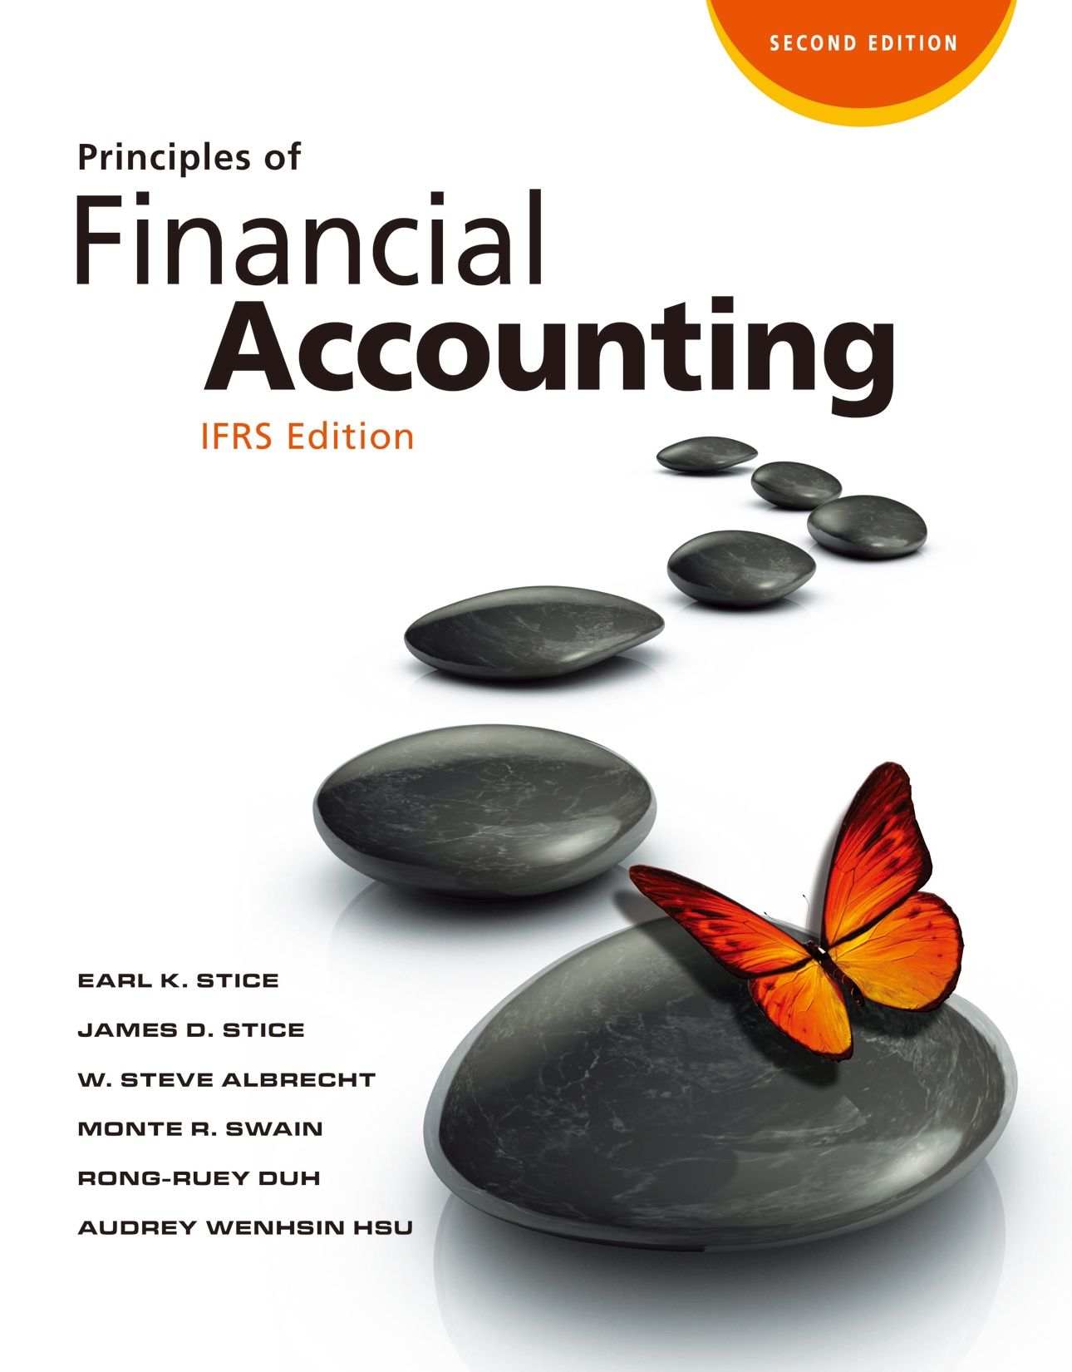

Slide 2
Investments: Property, Plant, and Equipment and Intangible Assets

Slide 3
Investments: Property, Plant, and Equipment and Intangible Assets

Slide 4
Long-Term Operating Assets
Nature of Long-Term Operating Assets
LO1
Long-term operating assets are those expected to be held and used over the course of several years to facilitate operating activities.
Unlike inventories, these assets are not acquired for resale to customers but are held and used by a business to generate revenues.

Slide 5
Long-Term Operating Assets
LO1
Property, Plant, and Equipment
Tangible, long-lived assets acquired for use in business operations.
Intangible Assets
Long-lived assets that are used in the operation of a business but do not have physical substance.
5

Slide 6
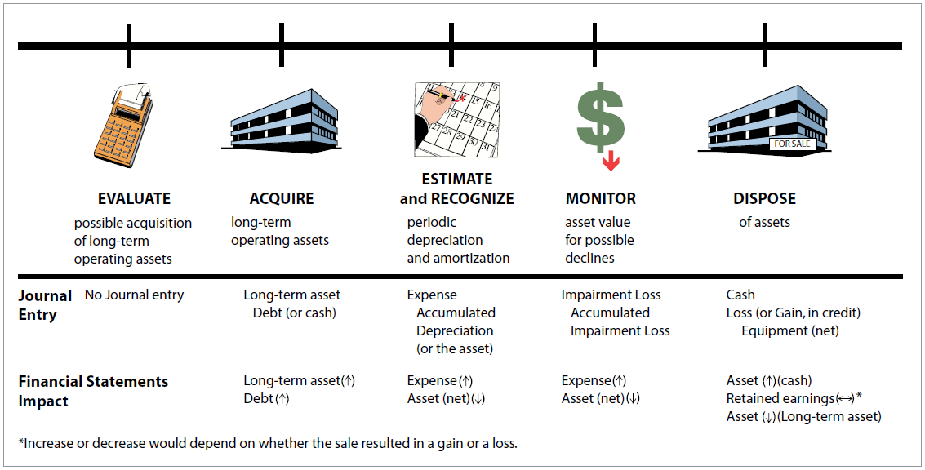
Long-Term Operating Assets
LO1
Business Issues Involved with Long-Term Operating Assets
Exhibit 9.1
6

Slide 7
Quiz Yourself
LO1
Are the following items tangible long-term operating assets?
Retained earnings
Licenses
Buildings
No—This is an equity item.
No—This is an intangible long-term operating asset.
Yes.

Slide 8
Quiz Yourself
LO1
Goodwill
Land
No—This is an intangible long-term operating asset.
Yes.

Slide 9
Accounting for Acquisition of PP&E
Accounting for Acquisition of Property, Plant, and Equipment
LO2
Like all other assets, property, plant, and equipment are initially recorded at cost.
The cost of an asset includes
The purchase price.
And any other costs incurred necessary in acquiring the asset and getting it ready for its intended use.

Slide 10
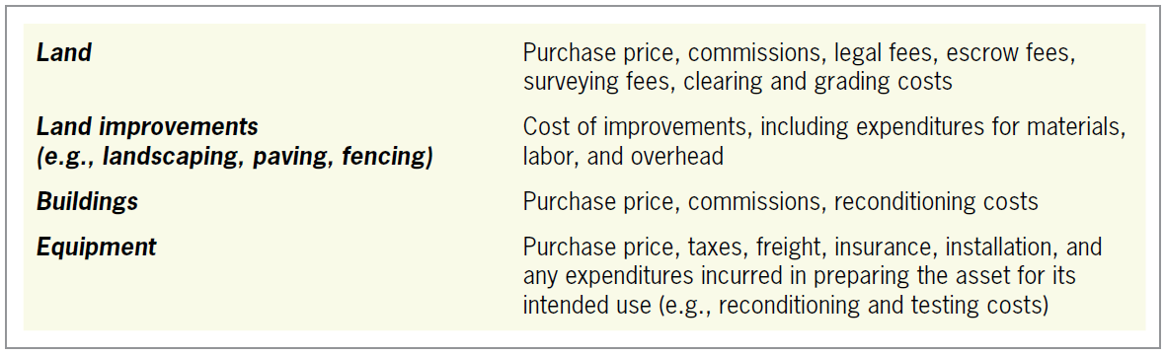
Accounting for Acquisition of PP&E
LO2
Acquisition Cost of PP&E
Exhibit 9.2

Slide 11
Assets Acquired by Purchase
LO2
Illustration
Wheeler Resorts, Inc., purchases a new delivery truck for £15,096 (purchase price of £15,000, less 2% discount for paying cash, plus sales tax of £396).
Delivery Truck
15,096
Cash
15,096
Purchased a delivery truck for £15,096 (£15,000 – £300 cash discount + £396 sales tax).

Slide 12
Assets Acquired by Purchase
LO2
Illustration
If the company had borrowed £12,000 of the £15,096 from a bank, the entry would have been:
Delivery Truck
15,096
Cash
3,096
Notes Payable
12,000
Purchased a delivery truck for £15,096; paid £3,096 cash and issued a note for £12,000 to Chemical Bank.

Slide 13
Acquisition of Several Assets at Once
LO2
Basket Purchase
Occurs when two or more assets are acquired together at a single price.
The relative fair market values of the assets are usually used to determine the respective costs to be assigned to the acquired assets.

Slide 14
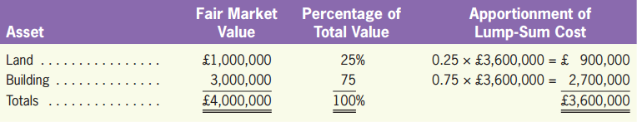
Acquisition of Several Assets at Once
LO2
Illustration
Wheeler purchases a 40,000-square-foot building on 2.6 acres of land for £3,600,000. An appraisal indicates that the fair market values of the land and the building are £1,000,000 and £3,000,000, respectively.

Slide 15
Acquisition of Several Assets at Once
LO2
Illustration
The journal entry to record this basket purchase is:
If only £1,000,000 is paid in cash and the rest are financed.
Land
900,000
Building
2,700,000
Cash
3,600,000
Purchased 2.6 acres of land and a 40,000-square-foot building.
Land
900,000
Building
2,700,000
Cash
1,000,000
Notes Payable
2,600,000

Slide 16
Quiz Yourself
LO2
Crosby Inc. purchased a parcel of land at the price of £2,800,000 with a building on it.
In addition, Crosby paid a brokerage fee of £80,000.
The fair market values of the land and the building are £800,000 and £2,400,000, respectively.
Make the journal entry to record the transaction.

Slide 17
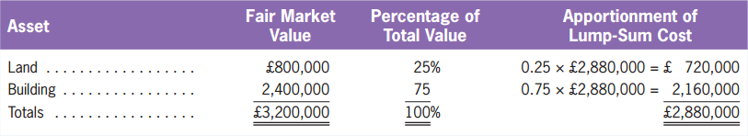
Quiz Yourself
LO2
Solution
The total cost of the transaction
= £2,800,000 + £80,000 = £2,880,000
Allocation of the total cost to the land and the building:

Slide 18
Quiz Yourself
LO2
Solution
The journal entry is as follows:
Land
720,000
Building
2,160,000
Cash
2,880,000

Slide 19
What is Depreciation?
Calculating and Recording Depreciation Expense
LO3
The allocation of an asset’s cost over its useful life.
The matching principle requires that the original cost of property, plant, and equipment be assigned to expense in the periods benefited from the use of the asset.
Land is not depreciated because it is usually assumed to have an unlimited useful life.
Carrying Amount or Book Value
The undepreciated cost.

Slide 20
How to Calculate Depreciation Expense?
LO3
Three Elements to Calculate Depreciation
Depreciation Method
Straight-Line Method of Depreciation
Units-of-Production Depreciation
Original cost
Estimated useful life
Estimated salvage (residual) value

Slide 21
Straight-Line Method of Depreciation
LO3
Assume that an asset will benefit all periods equally and that the cost should be assigned on a uniform basis for all periods.
Depreciable amount
Annual Depreciation
Expense
Cost - Salvage value
Estimated useful life (years)
=

Slide 22
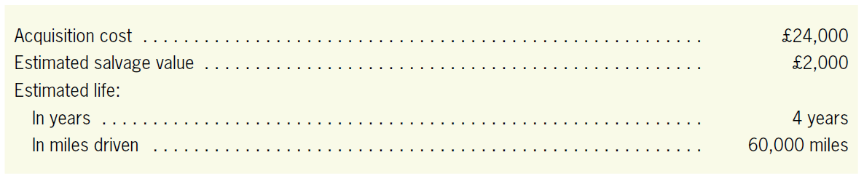
Straight-Line Method of Depreciation
LO3
Illustration
Assume that Wheeler purchased a van on January 1 for transporting hotel guests to and from the airport.
£24,000 - £2,000
4 years
£5,500
=

Slide 23
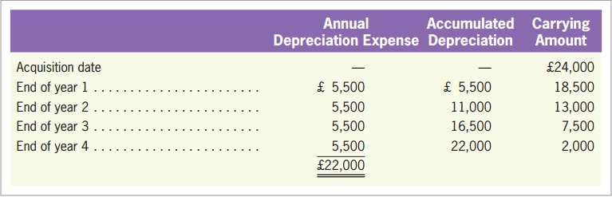
Straight-Line Method of Depreciation
LO3
Illustration
Depreciation Schedule
Exhibit 9.3

Slide 24
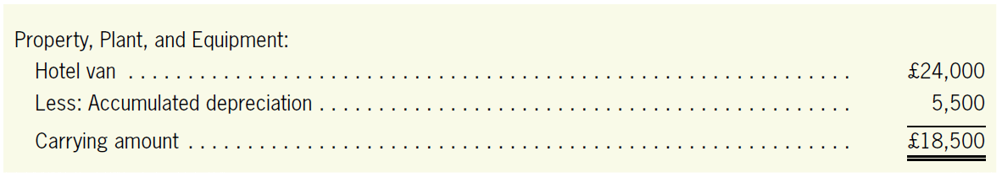
Straight-Line Method of Depreciation
LO3
Illustration
The entry to record the depreciation each year is:
At the end of the first year
Reported on the S/CI as a determinant of net income
Depreciation Expense
5,500
Accumulated Depreciation, Hotel Van
5,500
To record annual depreciation for the hotel van.
A contra-asset account on the B/S

Slide 25
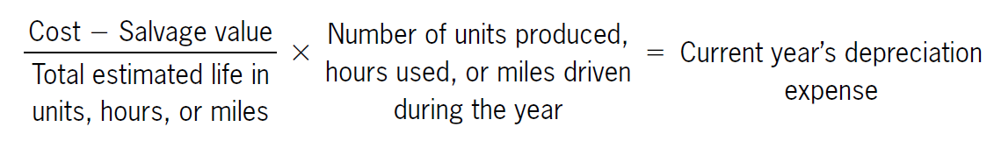
Units-of-Production Depreciation
LO3
Allocates an asset’s cost on the basis of use rather than time.
Assets with varying usage patterns for which this method of depreciation may be appropriate.

Slide 26
Units-of-Production Depreciation
LO3
Illustration
Consider Wheeler’s van, which has an expected life of 60,000 miles.
If the van is driven 12,000 miles during the first year, the depreciation expense for that year is:
(£24,000 - £2,000)
60,000 miles
£4,400
depreciation expense
x
=
12,000 miles
Depreciation Expense
4,400
Accumulated Depreciation, Hotel Van
4,400
To record depreciation for the first year of the hotel van’s life.

Slide 27
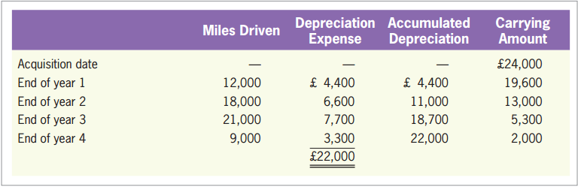
Units-of-Production Depreciation
LO3
Illustration
Depreciation Schedule
Exhibit 9.4

Slide 28
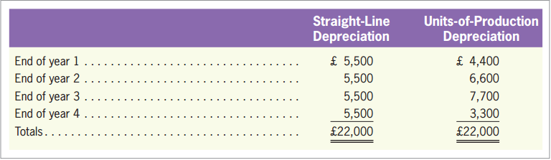
Comparison of the Two Methods
LO3
Note that part of the formulas for straight-line and units-of-production depreciation is the same.
Cost - Salvage value
Estimated useful life
Straight-line: years
Units-of-production: miles or hours
Exhibit 9.5

Slide 29
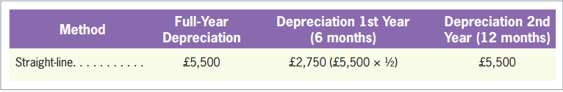
Partial-Year Depreciation Calculations
LO3
Illustration
Assume that Wheeler purchased its £24,000 van on July 1 instead of January 1.
The depreciation calculations for the first one and one-half years, using straight-line depreciation is as follows:
Exhibit 9.6

Slide 30
Units-of-Production Method with Natural Resources
LO3
Another common use for the units-of-production method is with natural resources.
Depletion: the same as depreciation conceptually.

Slide 31
Units-of-Production Method with Natural Resources
LO3
Illustration
Assume that Power-T Company purchases a coal mine for £1,200,000 cash.
If the mine contains an estimated 200,000 tons of coal deposits
Coal Mine
1,200,000
Cash
1,200,000
Purchased a coal mine for £1,200,000.
Depletion Expense
= £1,200,000/200,000 tons
= £6 per ton

Slide 32
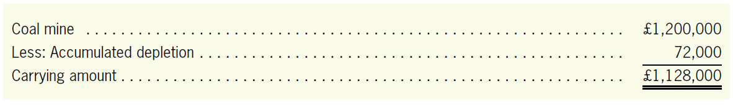
Units-of-Production Method with Natural Resources
LO3
Illustration
If 12,000 tons of coal are mined and sold in the current year, the depletion entry is:
The coal mine is shown on the balance sheet as follows:
Depletion Expense
72,000
Accumulated Depletion, Coal Mine
72,000
To record depletion for the year: 12,000 tons at £6 per ton.

Slide 33
Accelerated Depreciation: Declining-Balance Method
LO3
Accelerated Depreciation
Methods that assign more depreciation to the earlier years and less to the later years.
Declining-Balance Depreciation Method
An asset’s carrying amount is multiplied by a constant depreciation rate.
The initial computation ignores the asset’s salvage value.

Slide 34
Accelerated Depreciation: Declining-Balance Method
LO3
Double Declining-balance (DDB) Depreciation Method
If the 150% declining balance were being used instead, the 2 in the rate formula would be replaced by 1.5 and so on for any other percentages.
1
× 2
=
DDB rate
Estimated life (years)

Slide 35
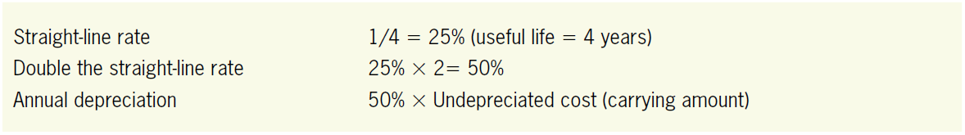
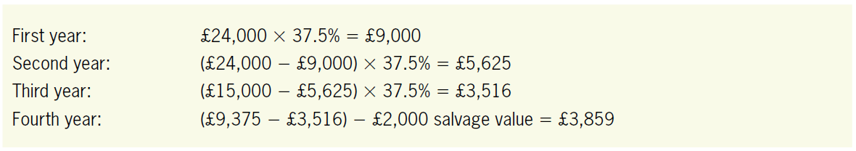
Accelerated Depreciation: Declining-Balance Method
LO3
Illustration
The Wheeler Example

Slide 36
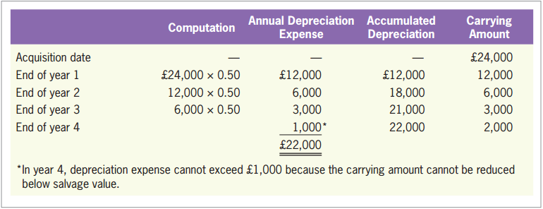
Accelerated Depreciation: Declining-Balance Method
LO3
Illustration
The Wheeler Example
Exhibit 9.7

Slide 37
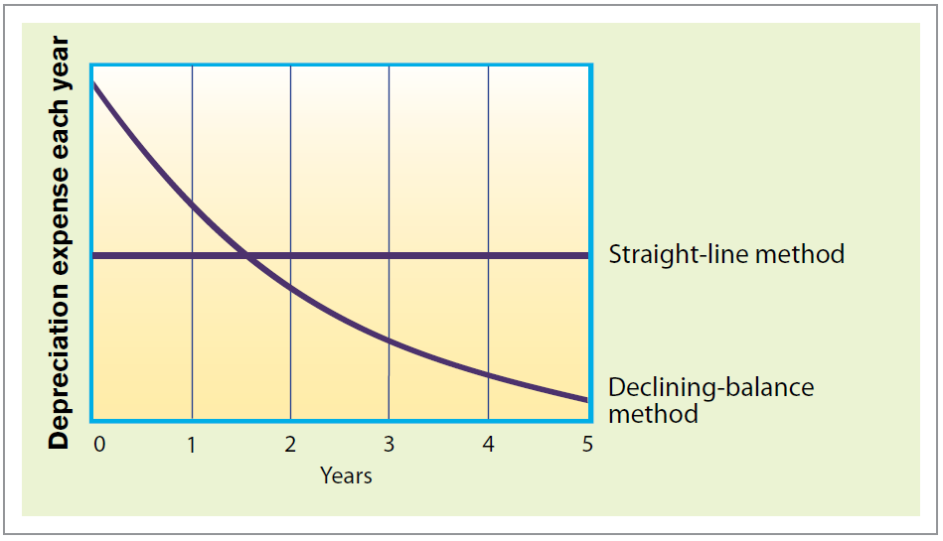
A Comparison of All Depreciation Methods
LO3
Exhibit 9.8

Slide 38
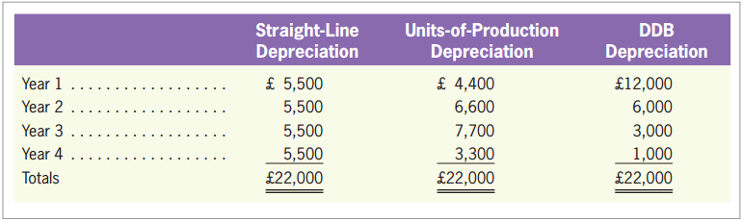
A Comparison of All Depreciation Methods
LO3
Exhibit 9.9

Slide 39
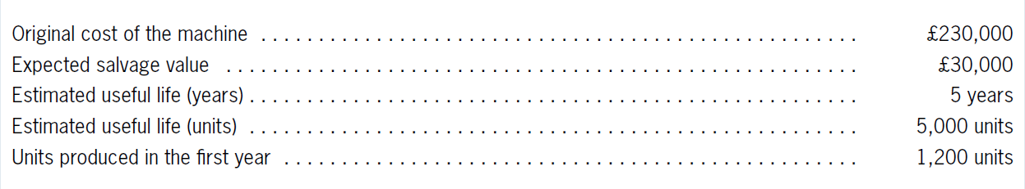
Quiz Yourself
LO3
The following data relate to a machine used by Mimi Company. The machine was acquired on January 1.

Slide 40
Quiz Yourself
LO3
Make the journal entry to record depreciation expense for the first year. Assume that Mimi uses the straight-line method.
Repeat (1) assuming that Mimi uses the units-of-production method.
Depreciation Expense
40,000
Accumulated Depreciation
40,000
(£230,000 – £30,000)/5 years = £40,000 per year.
Depreciation Expense
48,000
Accumulated Depreciation
48,000
(£230,000 – £30,000) × (1,200 units/5,000 units) = £48,000.

Slide 41
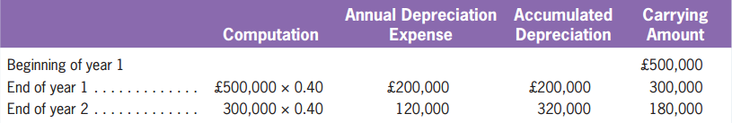
Quiz Yourself
LO3
Kenneth Jay Company purchased a piece of machinery for ￡500,000 on January 1. The machinery has an estimated useful life of five years and an estimated salvage value of ￡50,000.
Compute depreciation expense for year 1 and year 2 using the double-declining-balance depreciation method.
Double the straight-line rate: (1/5 years) × 2 = 0.40

Slide 42
Changes in Depreciation Estimates and Methods
Changes in Depreciation Estimates and Methods
LO4
Illustration
Wheeler’s van was assumed to have a useful life of 4 years and a salvage value of £2,000.
After 3 years, Wheeler realizes that the van will last another 3 years and that the salvage value will be £3,000 instead of £2,000.
Use the straight-line depreciation to calculate the depreciation expenses for the remaining 3 years.

Slide 43
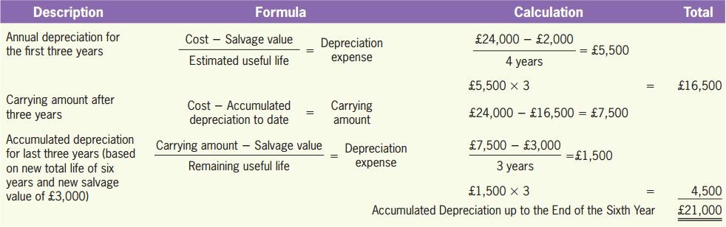
Changes in Depreciation Estimates and Methods
LO4
Illustration

Slide 44
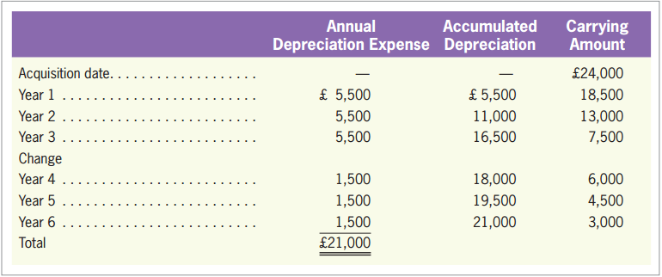
Changes in Depreciation Estimates and Methods
LO4
Illustration
Depreciation schedule when there is a change in estimate:
Exhibit 9.10

Slide 45
Quiz Yourself
LO4
Bodie Company purchased a piece of equipment for £200,000 on January 1 of year 1.
The equipment had an estimated useful life of eight years and an estimated salvage value of £40,000. Bodie uses the straight-line depreciation method.
During year 3, Bodie used its experience with the equipment to determine that the total useful life would be six years (instead of eight years) and that the salvage value would be £0 (instead of £40,000).
Compute depreciation expense for year 3.

Slide 46
Quiz Yourself
LO4
Solution
Depreciation expense in years 1 and 2:
(£200,000 − £40,000)/8 = £20,000
Carrying amount on January 1 of year 3:
£200,000 − (2 × £20,000) = £160,000
Remaining life on January 1 of year 3:
6 years − 2 years = 4 years remaining
Remaining salvage value on January 1 of year 3: £0
Year 3 depreciation expense: (£160,000 − £0)/4 = £40,000

Slide 47
Ordinary Expenditures (Revenue Expenditures)
Repairing and Improving Property, Plant, and Equipment
LO5
Typically benefit only the period in which they are made. (i.e., repairs, maintenance, and minor improvements)
Expense when incurred.

Slide 48
Ordinary Expenditures (Revenue Expenditures)
LO5
Illustration
Wheeler purchases a delivery truck for £42,000. This truck has an estimated useful life of eight years and a salvage value of £2,000.
The straight-line depreciation is £5,000 per year.
If the company spends £1,500 each year for normal maintenance, its annual recording of these expenditures is:
Repairs and Maintenance Expense
1,500
Cash
1,500
Spent £1,500 for maintenance of delivery truck.

Slide 49
Capital Expenditures
LO5
Three criteria:
Significant in amount.
Benefit more than the current period.
Increase the productive life or capacity of the asset (i.e., engine overhaul, components added).
Capitalize and add to asset value
Depreciated over the remaining life of the asset

Slide 50
Capital Expenditures
LO5
Illustration
Suppose that at the end of the sixth year of the truck’s useful life, Wheeler spends £8,000 to overhaul the engine. This expenditure will increase the truck’s remaining life from two to four years, but will not change its estimated salvage value.
Record the expenditure as follows:
Delivery Truck
8,000
Cash
8,000
Spent £8,000 to overhaul the engine of the £42,000 delivery truck.

Slide 51
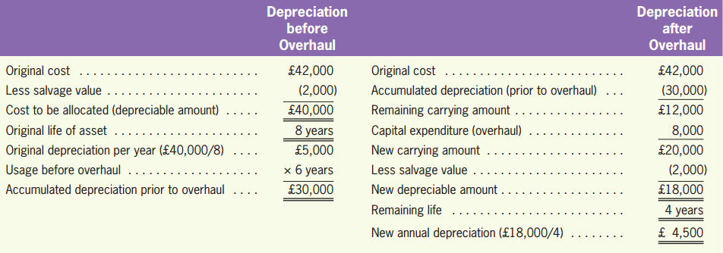
Capital Expenditures
LO5
Illustration
The depreciation for the last four years will be £4,500 per year.

Slide 52
Capital Expenditures
LO5
Certain improvements are considered permanent, like moving earth to change the land contour.
Capitalized as part of the land account.
Other expenditures may have a limited life, like those incurred in building a road, a sidewalk, or a fence.
Capitalized in a separate land improvements account and be depreciated over their useful lives.

Slide 53
Quiz Yourself
LO5
Polly Company has a truck.
As of January 1, the truck had a cost of £40,000, accumulated depreciation of £15,000, and an expected remaining life of 5 years.
On January 1, Polly spent £20,000 on repairs and improvements on the truck. Of this £20,000 amount, £5,000 is for routine maintenance and £15,000 is for improvements that are expected to increase the remaining life of the truck from 5 years to 10 years.

Slide 54
Quiz Yourself
LO5
Make the journal entry required to record the cash payment for the £20,000 in repairs and maintenance done on January 1.
Repairs and Maintenance Expense
5,000
Truck
15,000
Cash
20,000

Slide 55
Quiz Yourself
LO5
Make the journal entry required to record depreciation expense on the truck for the year. Polly uses the straight-line method. The truck has no expected salvage value.
Depreciation Expense
4,000
Accumulated Depreciation
4,000
Initial remaining carrying amount: £40,000 – £15,000 = £25,000
Capital expenditure: £15,000
New remaining life: 10 years
(£25,000 + £15,000)/10 years = £4,000 per year

Slide 56
Impairments
Recording Impairments of Asset Value
LO6
Events occur after the purchase of an asset that significantly reduce its value.
When there are indications that an asset is impaired, the company should perform an impairment test.

Slide 57
Impairment Test
LO6
Recoverable Amount
The higher of net fair value of the asset or value in use of the asset.
Net Fair Value
The fair value of the asset after subtracting the disposal cost (direct selling cost, for example).
Value in Use
The present value of the expected future cash flows generated by the asset.

Slide 58
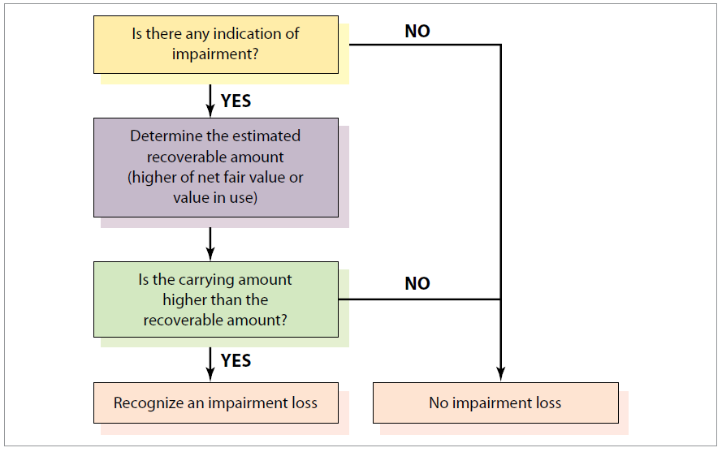
Impairment Test
LO6
Exhibit 9.11

Slide 59
Recording an Impairment Loss
LO6
Illustration
Wheeler purchased a fitness center building five years ago for £600,000. The building has been depreciated using the straight-line method with a 20-year useful life and no residual value. Wheeler estimates that the building has a remaining useful life of 15 years.
There are indications that the value of the building may be impaired. Wheeler estimates that the present value of cash flows generated by the building over the next 15 years is £375,000, and that the net fair value of the building is £230,000.

Slide 60
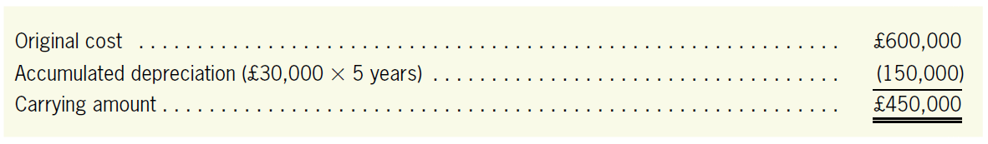
Recording an Impairment Loss
LO6
Illustration
Carrying amount of the building:
Recoverable amount of the building (the higher of value in use or net fair value):
value in use £375,000
net fair value £230,000

Slide 61
Recording an Impairment Loss
LO6
Illustration
Carrying amount
£450,000
Recoverable amount
£375,000
>
Impairment Loss: £450,000 - £375,000 = £75,000
A non-operating expense.
Dec. 31,
year 5
Depreciation Expense
30,000
Accumulated Depreciation, Building
30,000
Impairment Loss
75,000
Accumulated Impairment Losses, Building
75,000
A contra-asset account of PP&E.

Slide 62
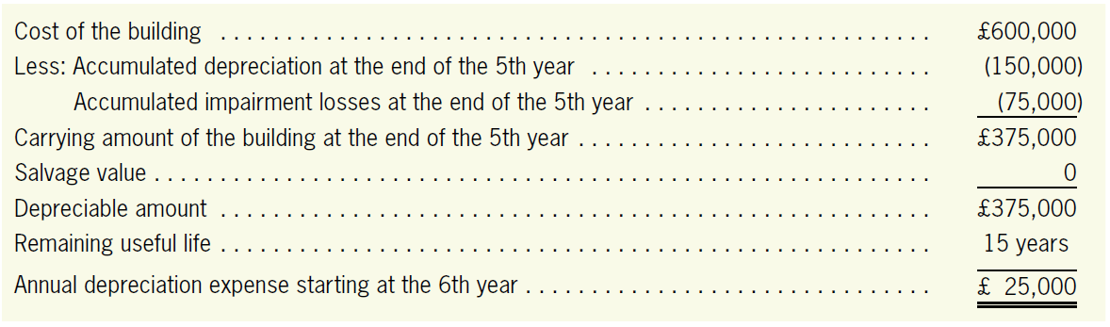
Recording an Impairment Loss
LO6
Illustration
Depreciation expense for the remaining years (year 6-20):
Dec. 31, year 6
Depreciation Expense
25,000
Accumulated Depreciation, Building
25,000

Slide 63
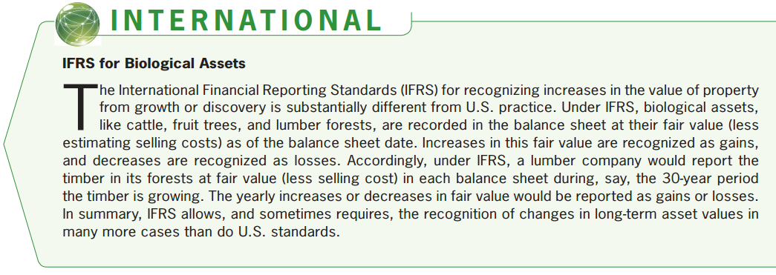
Impairment
LO6

Slide 64
Quiz Yourself
LO6
Amber Company purchased a building 10 years ago for £900,000. As of January 1 of the current year, the building has accumulated depreciation of £270,000. The building has a fair value of £500,000, and its direct selling cost is £20,000. The value in use that can be generated by the building is £500,000.

Slide 65
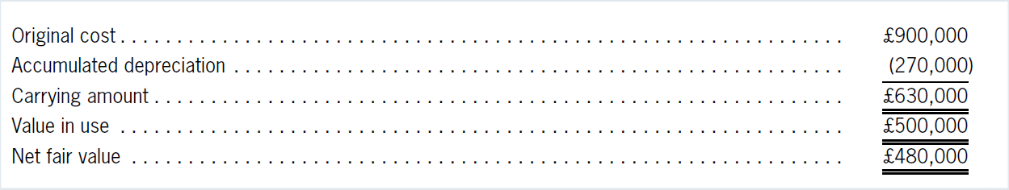
Quiz Yourself
LO6
Show the calculations that demonstrate that the building is impaired.
Make the journal entry to record the impairment loss.
Impairment Loss
130,000
Accumulated Impairment Losses
130,000

Slide 66
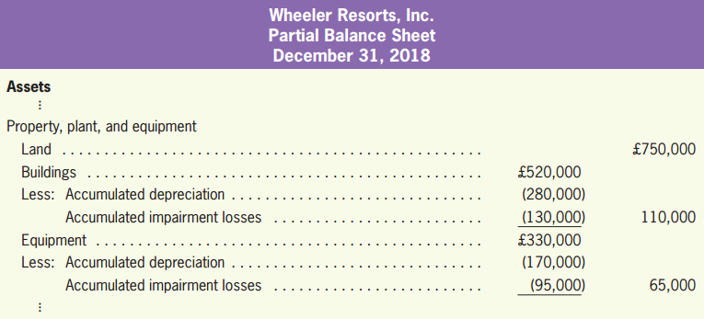
Reporting PP&E
Reporting Property, Plant, and Equipment
LO7

Slide 67
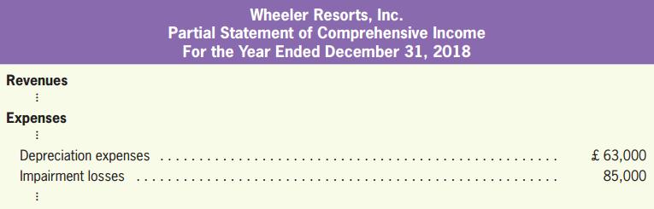
Reporting PP&E
LO7

Slide 68
Disposal of Property, Plant, and Equipment
Disposal of Property, Plant, and Equipment
LO8
Basically three ways to dispose of an item of property, plant, and equipment:
1. Discard (or scrap) it
2. Sell it
3. Exchange it for another asset
(Expanded Materials)

Slide 69
Discarding Property, Plant, and Equipment
LO8
Illustration
Wheeler purchases a computer for £15,000. The computer has a five-year life and no estimated salvage value and is depreciated on a straight-line basis.
If the computer is scrapped after five full years, the entry to record the disposal is as follows:
Accumulated Depreciation, Computer
15,000
Computer
15,000
Scrapped £15,000 computer.

Slide 70
Discarding Property, Plant, and Equipment
LO8
Illustration
If Wheeler must pay £300 to have the computer dismantled and removed, the entry to record the disposal is:
Accumulated Depreciation, Computer
15,000
Loss on Disposal of Computer
300
Computer
15,000
Cash
300
Scrapped £15,000 computer and paid disposal costs of £300.

Slide 71
Discarding Property, Plant, and Equipment
LO8
Illustration
If the computer had been scrapped after only four years of service (and after £12,000 of the original cost has been depreciated), the entry would have been:
Accumulated Depreciation, Computer
12,000
Plus the undepreciated amount of £3,000
Loss on Disposal of Computer
3,300
Computer
15,000
Cash
300
Scrapped £15,000 computer and paid disposal costs of £300.

Slide 72
Selling Property, Plant, and Equipment
LO8
Illustration
Consider Wheeler’s £15,000 computer. If the computer is sold for £600 after 5 full years of service, assuming no disposal costs, the entry to record the sale is:
Cash
600
Accumulated Depreciation, Computer
15,000
Computer
15,000
Gain on Sale of Computer
600
Sold £15,000 computer at a gain of £600.

Slide 73
Selling Property, Plant, and Equipment
LO8
Illustration
If the computer had been sold for £600 after only 4 years of service, the entry to record the sale would have been:
Cash
600
Accumulated Depreciation, Computer
12,000
Loss on Sale of Computer
2,400
Computer
15,000
Sold £15,000 computer at a loss of £2,400.

Slide 74
Quiz Yourself
LO8
Didericksen Company sold a truck with a historical cost of £50,000 and accumulated depreciation of £24,000 for £30,000 cash. Make the journal entry necessary to record the sale of the truck.
Solution
The journal entry to record the sale of the truck for £30,000 cash is as follows:
Cash
30,000
Accumulated Depreciation
24,000
Gain on Sale of Truck
4,000
Truck
50,000

Slide 75
Intangible Assets
Accounting for Intangible Assets
LO9
Rights and privileges that are:
Long-lived.
Not held for resale.
Have no physical substance.
Providing owner with competitive advantage over other firms.

Slide 76
Intangible Assets
LO9
Internally Generated Intangible Assets
Not recognized on the balance sheet, but are still valued by the stock market.
Acquired Intangible Assets
Valued at the amount paid to acquire them.

Slide 77
Common Types of Intangibles
LO9
Patent
Patent is an exclusive right granted by a national government that enables an inventor to control over a period of time the manufacture, sale, or use of an invention or design.
The cost of a patent includes purchase price, filing and registry fees, and cost of subsequent litigation to protect right.
The expenditures during the research and development stages are not included.

Slide 78
Common Types of Intangibles
LO9
Trademark
A distinctive name, symbol, or slogan that distinguishes a product or service from similar products or services.
Copyrights
An exclusive right granted by a national government that permits an author to sell, license, or control his/her work over a period of time.

Slide 79
Common Types of Intangibles
LO9
Franchises
An entity that has been licensed to sell the product of a manufacturer or to offer a particular service in a given area.
The recorded cost of the franchise includes any sum paid specifically for the franchise right as well as legal fees and other costs incurred in obtaining it.
License
License is also a form of franchise.

Slide 80
Common Types of Intangibles
LO9
Goodwill
Represents the business contacts, reputation, functioning systems, staff camaraderie, and industry experience that make a business much more than just a collection of assets
Recognized only when it is purchased as part of the acquisition of another company.

Slide 81
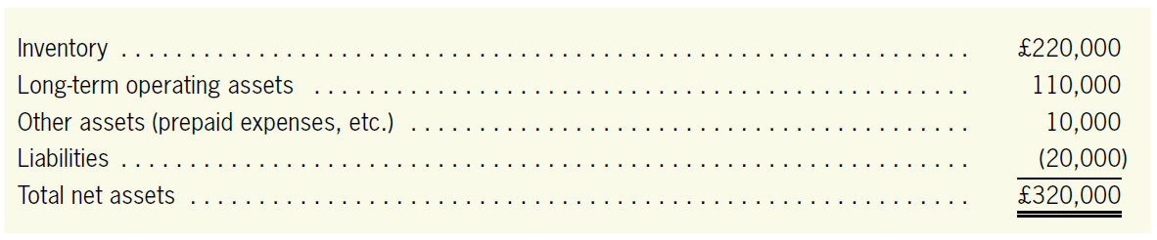
Accounting for Intangible Assets
LO9
Illustration
Assume that Wheeler purchases Valley Drug Store for £400,000. At the time of purchase, the recorded assets and liabilities of Valley Drug have the following fair market values:

Slide 82
Accounting for Intangible Assets
LO9
Illustration
Because Wheeler was willing to pay £400,000 for Valley Drug, there must have been other favorable, intangible factors worth approximately £80,000.
Inventory
220,000
Long-Term Operating Assets
110,000
Other Assets
10,000
Goodwill
80,000
Liabilities
20,000
Cash
400,000
Purchased Valley Drug Store for £400,000.

Slide 83
Amortization of Intangible Assets
LO9
Amortization
The process of cost allocation that assigns the original cost of an intangible asset to the periods benefited.
Straight-line amortization is generally used.
Generally assumed to have no salvage value.

Slide 84
Amortization of Intangible Assets
LO9
Amortization
Intangibles with an indefinite life, such as goodwill or a broadcast license that includes an extension option that can be renewed indefinitely, is not amortized.
Intangibles with a finite life is to be amortized over its estimated life.

Slide 85
Amortization of Intangible Assets
LO9
Illustration
Assume that Wheeler’s patent, with a legal life of 20 years, was purchased from another company after seven years. Because 7 years of its 20-year legal life have already elapsed, the patent now has a legal life of only 13 years.
If its useful life is assumed to be eight years, one-eighth of the £200,000 cost should be amortized each year for the next eight years.
Amortization Expense, Patent
25,000
Patent
25,000
To amortize one-eighth of the cost of the patent.

Slide 86
Impairment of Intangible Assets
LO9
All intangible assets (except those are not amortized such as goodwill) must be evaluated every year to determine if
The estimated useful life has changed.
The intangible asset has become impaired.

Slide 87
Quiz Yourself
LO9
W.W. Cole Company purchased an operating license for £40,000 cash on January 1.
Make the journal entry necessary to record the purchase of the license.
Assume that the license has an expected useful life of five years. make the journal entry necessary to record amortization expense at the end of the first year.
The credit could also have been made to Accumulated Amortization.
License
40,000
Cash
40,000
Amortization Expense (£40,000/5 years)
8,000
License
8,000

Slide 88
Quiz Yourself
LO9
Assume that the license can be renewed automatically and therefore has an indefinitely long useful life. Make the journal entry necessary to record amortization expense at the end of the first year.
Because the license has an indefinite useful life, no amortization expense is recorded. This assumption of an indefinite useful life would be reviewed periodically.

Slide 89
Evaluating the Level of PP&E
Measuring Property, Plant, and Equipment Efficiency
LO10
Fixed Asset Turnover (or PP&E Turnover)
Give a rough indication of how efficiently a company is utilizing its property, plant, and equipment to generate sales.
The number of dollars in sales generated by each dollar of fixed assets.
Sales
Average PP&E

Slide 90
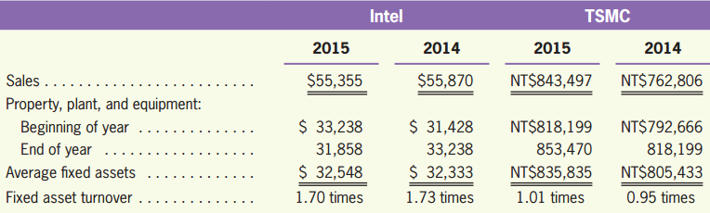
Evaluating the Level of PP&E
LO10
Illustration
Standard values for this ratio differ from industry to industry.

Slide 91
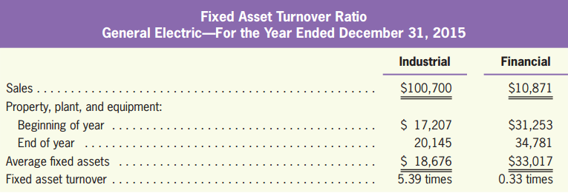
Industry Differences in Fixed Asset Turnover
LO10
Illustration
The fixed asset turnover ratio for the manufacturing segments of General Electric was 5.39 in 2015, over triple the ratio value for the company as a whole.

Slide 92
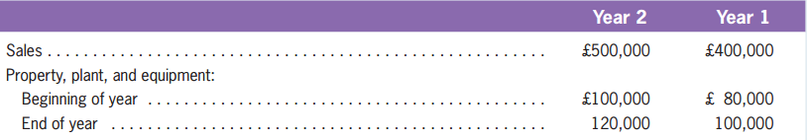
Quiz Yourself
LO10
Winmill Company reports the following numbers for year 1 and year 2.
Compute the fixed asset turnover ratio for year 1 and year 2.

Slide 93
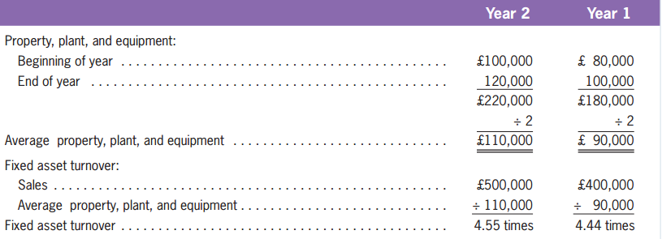
Quiz Yourself
LO10
Solution

Slide 94
Exchanging Property, Plant, and Equipment*
Exchanging Property, Plant, and Equipment
LO11
Companies often record a gain or loss on the exchange of PP&E for the reason that most exchanges have commercial substance.
An exchange has commercial substance if the future cash flows change as a result of the exchange.

Slide 95
Exchanging Property, Plant, and Equipment*
LO11
Eliminate the carrying amount of the asset given up.
Determine and record the cost of the asset acquired.
Recognize the gain or loss on the exchange.

Slide 96
Exchanging Property, Plant, and Equipment*
LO11
Illustration
Wheeler exchanges cars with machines held by Whitney. It is likely that the timing and amount of cash flows generated from the use of cars will differ significantly from those from the use of the machines.
As a result, both Wheeler and Whitney are in different economic positions; and therefore, the exchange has commercial substance.

Slide 97
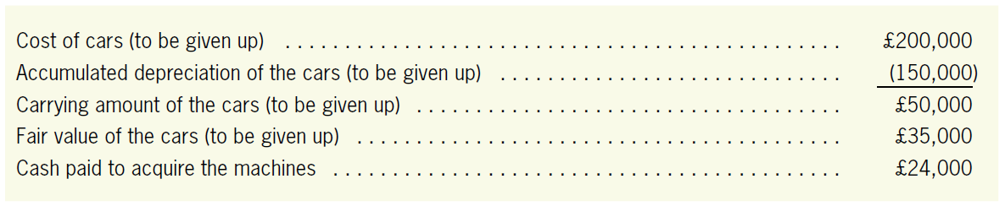
Exchanging Property, Plant, and Equipment*
LO11
Illustration
The cost of the acquired machine

Slide 98
Exchanging Property, Plant, and Equipment*
LO11
Illustration
Machinery Equipment
59,000
Accumulated Depreciation, Transportation Equipment
150,000
Loss on Exchange of Assets
15,000
Transportation Equipment
200,000
Cash
24,000

Slide 99
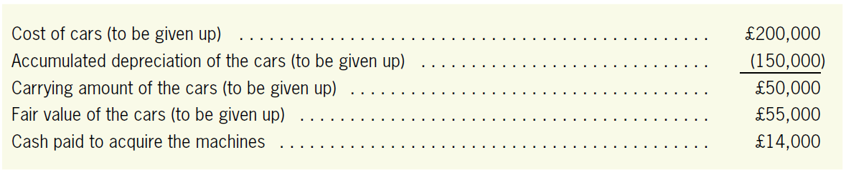
Exchanging Property, Plant, and Equipment*
LO11
Illustration
Now we illustrate a case of recognizing an exchange gain assuming the following information.
The cost of the acquired machine

Slide 100
Exchanging Property, Plant, and Equipment*
LO11
Illustration
Now we illustrate a case of recognizing an exchange gain assuming the following information.
Machinery Equipment
69,000
Accumulated Depreciation, Transportation Equipment
150,000
Transportation Equipment
200,000
Cash
14,000
Gain on Exchange of Assets
5,000

Slide 101
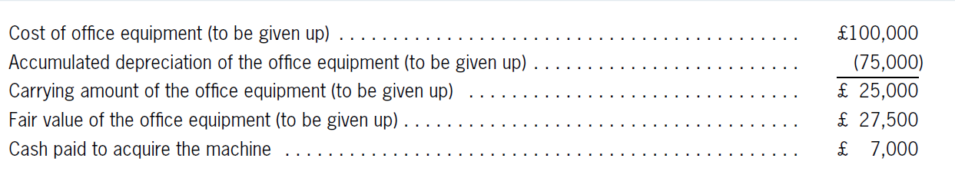
Quiz Yourself
LO11
Jennings Company exchanges its office equipment for a machine. Use the following information to record the exchange, assuming that this exchange has commercial substance.

Slide 102
Quiz Yourself
LO11
Solution
Machinery Equipment
34,500
Accumulated Depreciation, Office Equipment
75,000
Office Equipment
100,000
Cash
7,000
Gain on Exchange of Assets
2,500

Slide 103
The Revaluation Model*
The Revaluation Model
LO12
IFRS (IAS 16) allows a company to choose between cost model and revaluation model in valuing the PP&E.
Once a model is chosen, it should be applied to the entire class of assets.
Carrying amount
Fair
value
Accumulated depreciation
Accumulated impairment losses
=
-
-

Slide 104
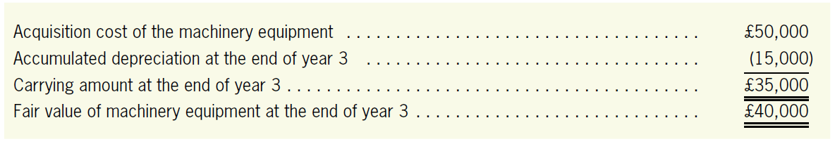
Revaluation Gain*
LO12
Illustration
Suppose that Wheeler chooses the revaluation model with the following information.
In preparing the journal entries, IAS 16 proposes two alternatives: the “proportionate restatement” approach and the “elimination” approach.

Slide 105
Revaluation Gain*
LO12
Illustration-The Elimination Method
Under this approach, the balance of the accumulated depreciation account is written off (cleaned up) and the balance of the equipment account is adjusted to the fair value.
Dec. 31,
year 3
Accumulated Depreciation–Machinery Equipment
15,000
Machinery Equipment
10,000
Revaluation Surplus–Machinery Equipment
5,000

Slide 106
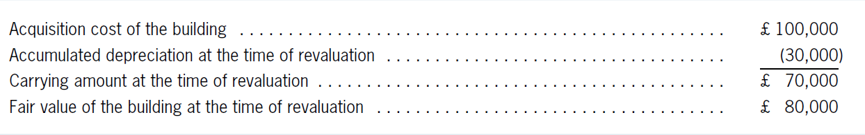
Quiz Yourself
LO12
Rayburn Company chooses the revaluation model to measure its building. Use the elimination approach to record the revaluation based on the following information.

Slide 107
Quiz Yourself
LO12
Solution
Accumulated Depreciation, Building
30,000
Building
20,000
Revaluation Surplus, Building
10,000

